Slide 1




NSPIRE INSPECTION
Landlord
Training Seminar
NSPIRE IS HERE!
ARE YOU READY?
Dennis DiBello,
COO/Chief Inspector
July 12, 2023
PHA: July 1, 2023
MF: October 1, 2023

Slide 2

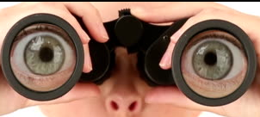
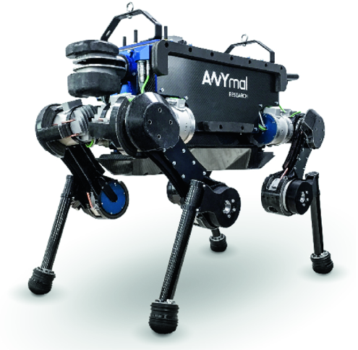
UPCS-V
circa 2016
REAC/UPCS
circa 1998
History of Housing Inspection
HQS
circa 1985
“The Future”
“The Past”
NSPIRE
circa 2018

Slide 3
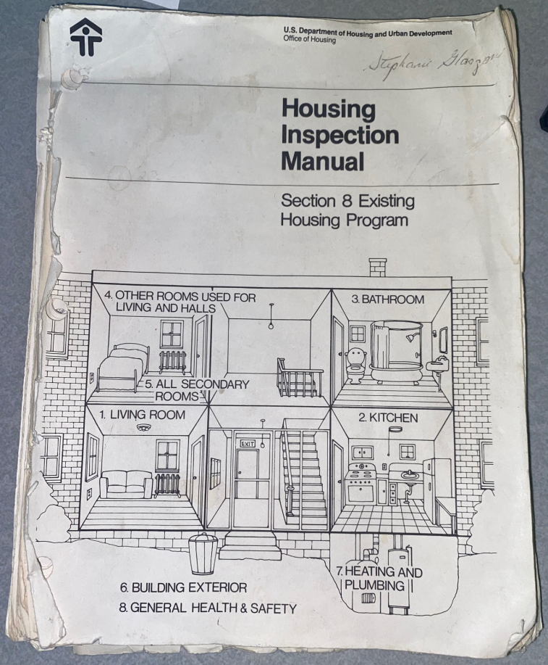
Relies Heavy on inspector judgement
History of Housing Inspection - HQS
To look to the future of inspections, it is good to reflect back. Inspections of housing dates back to the early 1980s.
Inspections started with a minimum housing standards. What constituted acceptable housing.
Around 1985 HUD issued a document which defined a room-by-room and item-by-item specifications.
The Origin of Housing Inspection

Slide 4
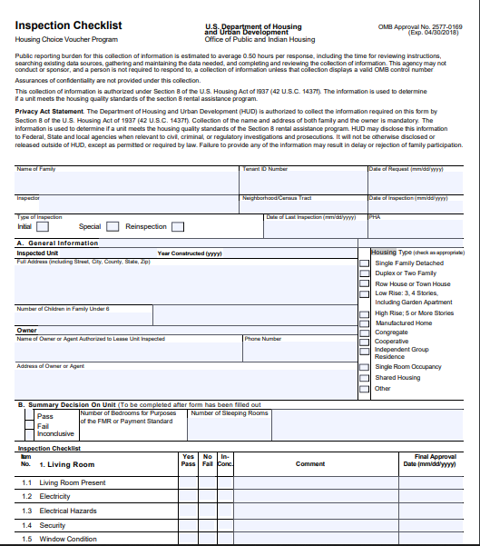
Look in an area at an item ….. Determine:
pass-fail.
History of Housing Inspection _ HQS
A room/item list was developed and a familiar form was deployed for the inspector:
Housing Quality Standards (HQS) Inspection Form and Checklist: HUD 52580.
The goal of the inspection is to provide "decent, safe, and sanitary" housing at affordable cost to lower income families.
HQS is a pass/fail system based on Inspector judgment.
Due to inconsistencies, housing inspection needed to be more sophisticated.
Defined basic quality housing standards based on 13 key aspects
Living Room
Kitchen
Bathroom
Other Room Used for Living
All Secondary Heating & Plumbing
Site & Neighborhood
HQS Housing Inspection

Slide 5
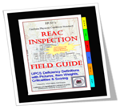
Relies Heavy on definitions
History of Housing Inspection - UPCS
In 1998, HUD form a new group called the
Real Estate Assessment Center (REAC). One of
REAC’s responsibilities is to evaluate the physical condition of any type property.
REAC ‘s inspection protocol called Uniform Physical Condition Standard (UPCS.) changed the inspection protocol and process using software, handheld computers and well defined definitions.
REAC/UPCS includes a numeric scoring system to account for the condition of the physical condition.
HUD’s mission changed to ensure decent, safe, and sanitary housing in good repair.
Consistency
Repeatability
Limit Inspector
Discretion
REAC - UPCS

Slide 6
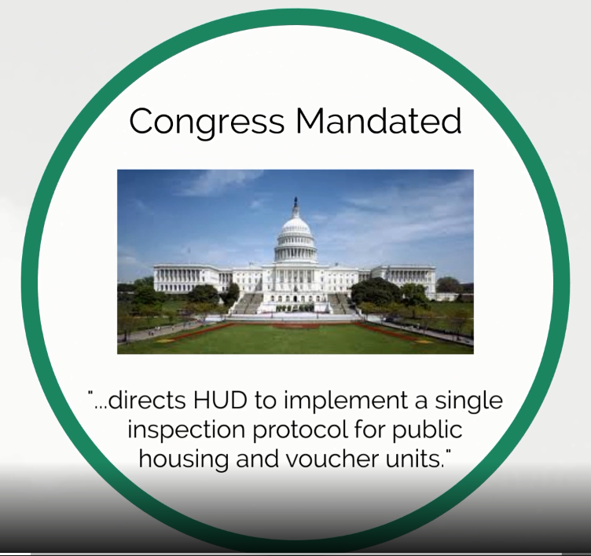
History of Housing Inspection – UPCS-V
After UPCS was implement for HUD funded housing, HQS still existed for voucher program. In 2016 Congress mandated that one inspection protocol be devised for all housing inspections.
One inspection method for all government funded housing
In 2017 a two year pilot program was proposed to convert HQS inspection to UPCS-V using the format of UPCS in a pass/fail manner. Also alternative inspection methods (RVI) were defined and tested in the UPCS-V pilot program.
In 2019, the UPCS-V pilot was renewed for another two years.
Alignment of Housing Inspection

Slide 7
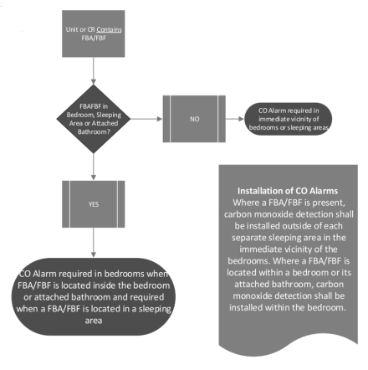
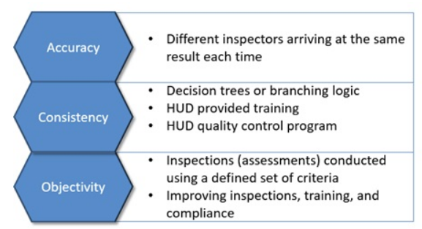
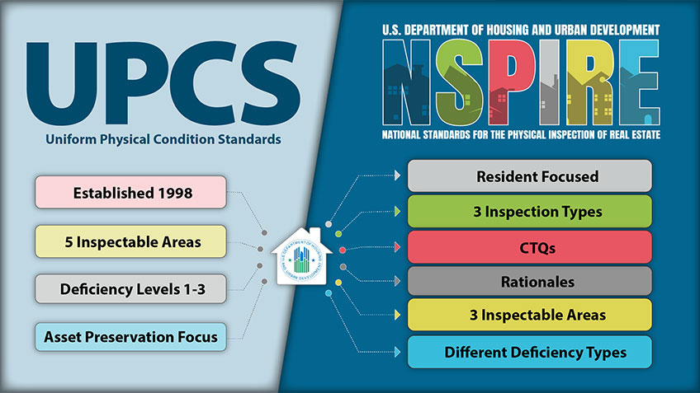
Decision Tree Analysis
History of Housing Inspection -
At the beginning of 2019, HUD announced a major replacement for the UPCS inspection program.
A new inspection model was needed to:
Focus on H&S effecting the resident
Ensure no poor unit conditions
Align scoring model
Ensure year round maintenance
Ensure deficiencies are Critical to Quality (CTQ.)
UPCS was slated for conversion to NSPIRE by 2020. In June 2021, UPCS-V pilot was absorbed into NSPIRE as the NSPIRE-V pilot.
DTA directs Inspector
Observations
NSPIRE Inspection Model

Slide 8
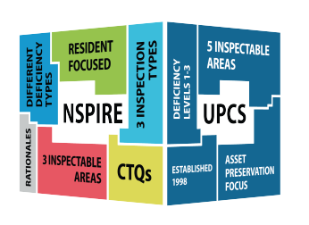
History of Housing Inspection
Where we are right now:
  HQS (~38 yrs)
  UPCS (~25 yrs)
  UPCS-V Pilot (~4 yrs-ended)
  NSPIRE (&V) Pilot (~4 yrs)
…with the mandated goal: All inspections use NSPIRE by
July FY2023 (PHAs) & October FY2023 (MFs)
Started in 2019; Implement REAC/NSPIRE Model
Housing Inspection Today

Slide 9
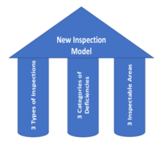
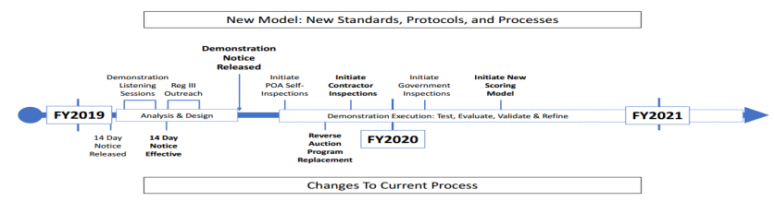
NEW Inspection Model

Slide 10
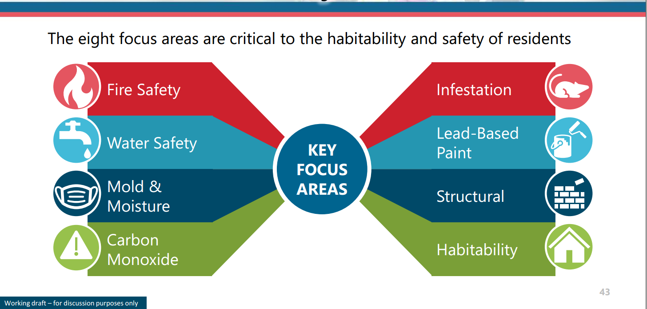
NSPIRE: Core Health & Safety Focus

Slide 11
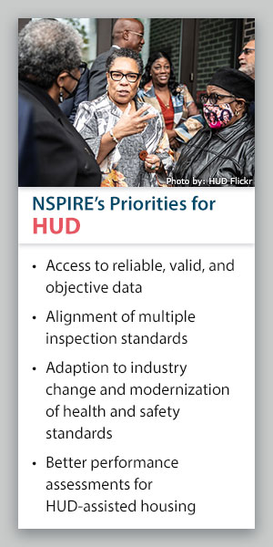
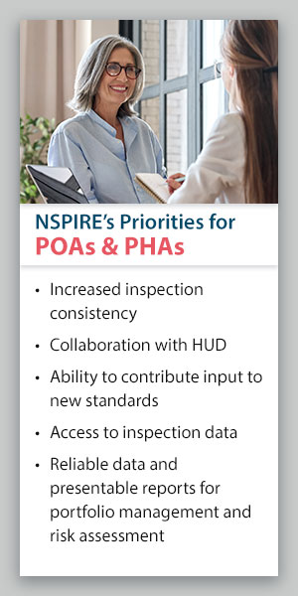
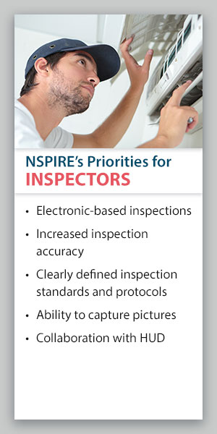
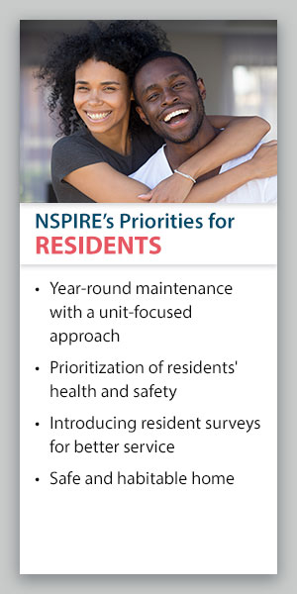
NSPIRE Priorities

Slide 12
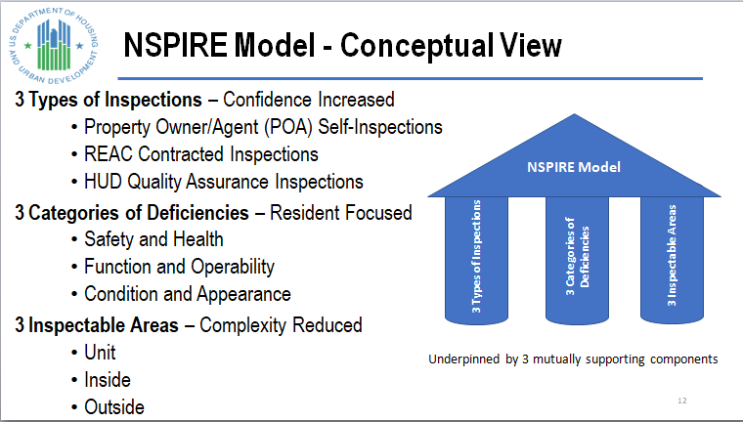
Track 2: New REAC Inspection Model
3-3-3 Deal

Slide 13
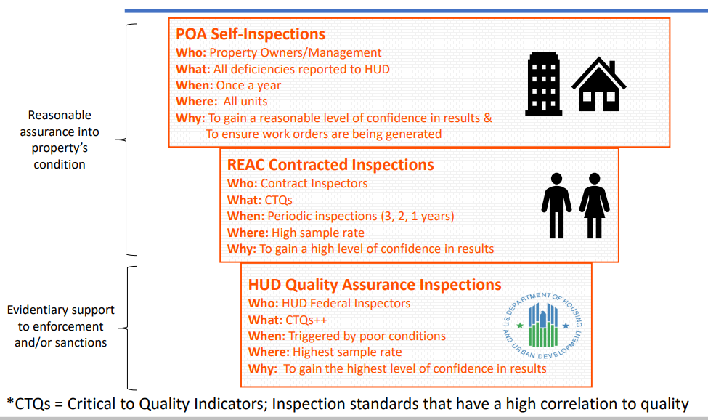
Track 2: NSPIRE: 3 Types of Inspections
Notes:
For the first time, incorporate comprehensive, annual self-inspections by property management staff, the methods and results of which will be integral parts of HUD's real estate inspection process. By making regular, comprehensive self-inspections a part of HUD's physical assessment regimen, property managers will be more engaged in the process and more vested in the outcomes.

Slide 14
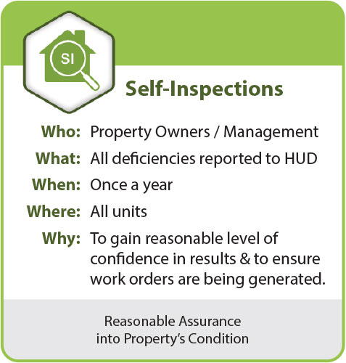
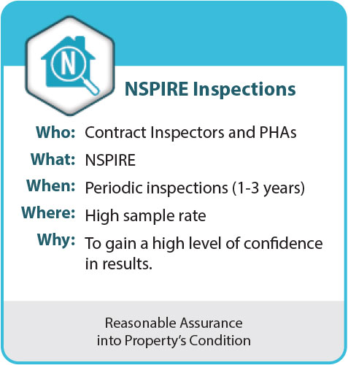
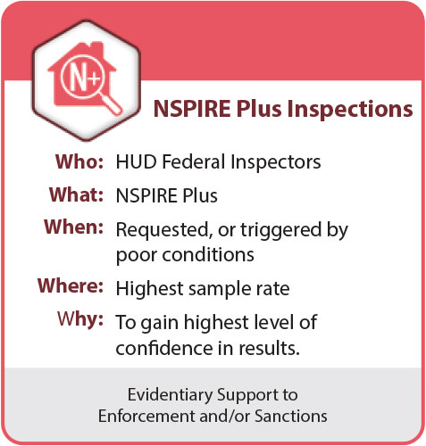
Track 2: NSPIRE: 3 Types of Inspections
Notes:
For the first time, incorporate comprehensive, annual self-inspections by property management staff, the methods and results of which will be integral parts of HUD's real estate inspection process. By making regular, comprehensive self-inspections a part of HUD's physical assessment regimen, property managers will be more engaged in the process and more vested in the outcomes.

Slide 15
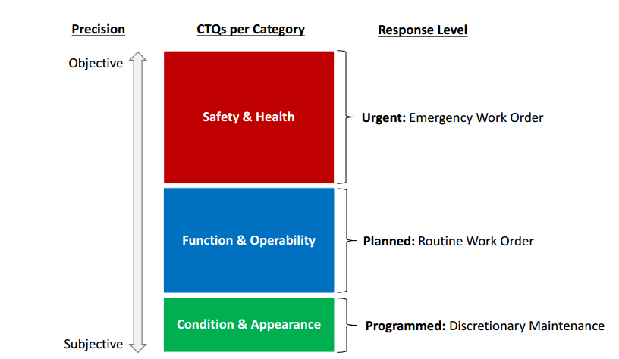
Track 2: NSPIRE: 3 Categories of Deficiencies w/ Maintenance Repair Times
Repair LT/SNLT reporting via REAC Secure Systems
Repair Time
S&H - 24 hr – LT, SNLT
F&O - 30 day – SNLT, STD
C&A – 60 day

Slide 16
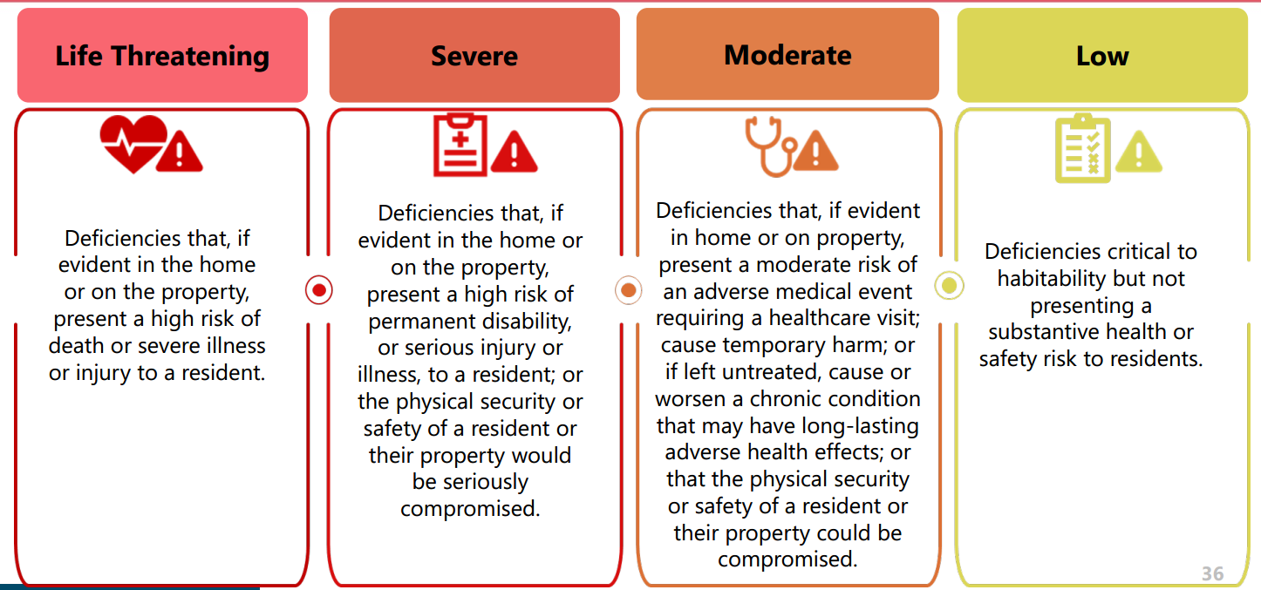
H&S Determinations
*HVC
24 hr
24 hr/30 day*
30 day
60 day

Slide 17
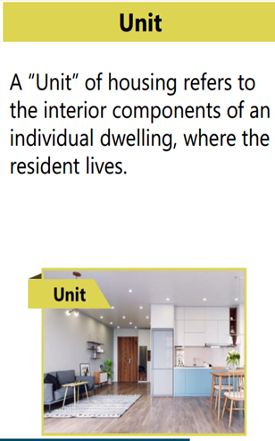
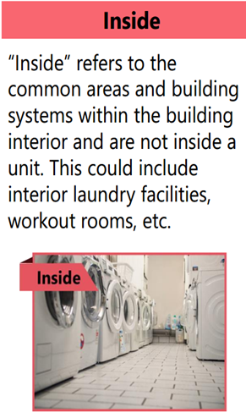
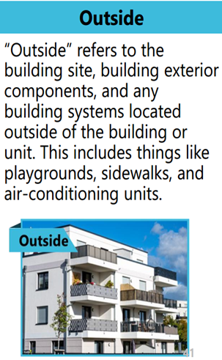
Track 2: NSPIRE: 3 Inspectable Areas

Slide 18
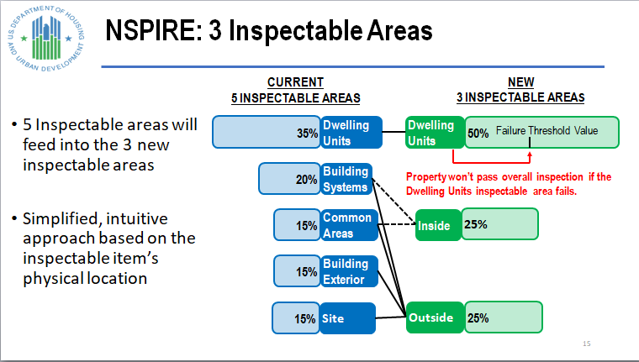
Track 2: NSPIRE: 3 Inspectable Areas

Slide 19
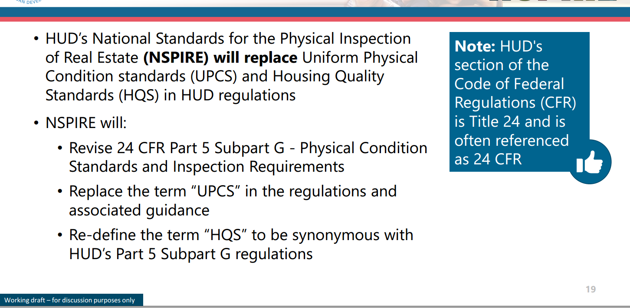
NSPIRE Replaces UPCS & HQS

Slide 20
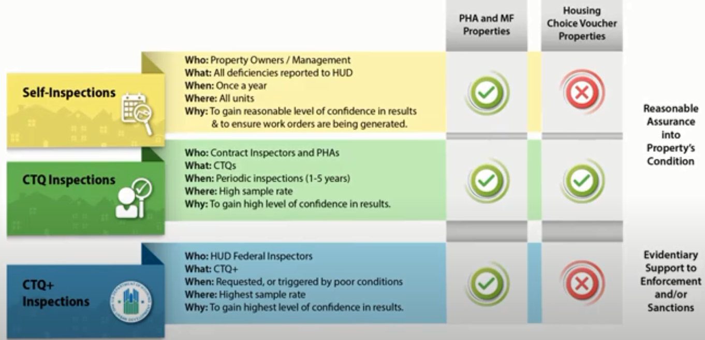
Track 2: NSPIRE: HCV-HQS

Slide 21
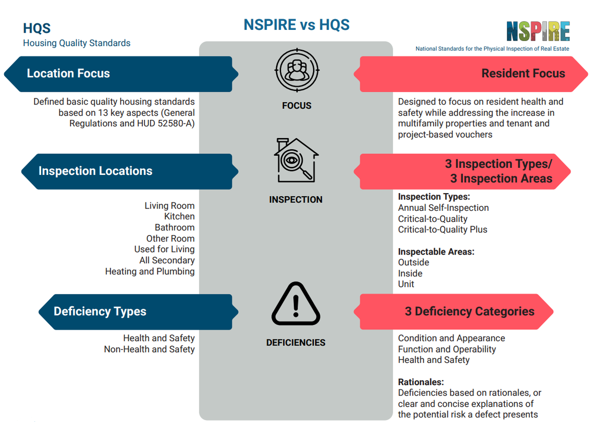

Slide 22
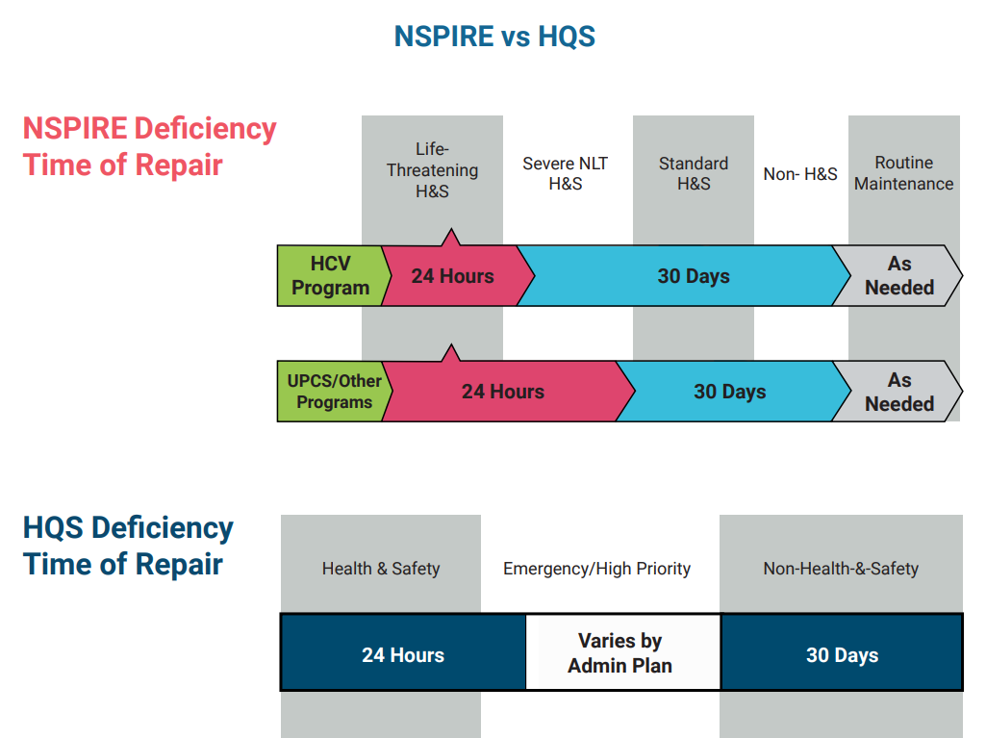

Slide 23

NSPIRE PILOT DEMONSTRATION
Two Concurrent Demonstrations Underway
  NSPIRE for Public Housing and Multifamily (NSPIRE)
  NSPIRE for Vouchers (NSPIRE-V)
NSPIRE Demonstration
Goal: 4500 Properties
NSPIRE-V (HQS conversion)
Ongoing
113 volunteer PHA to date
1300 properties inspected using NSPIRE
Completion
April 30 - PHA
Oct 1 - MF

Slide 24
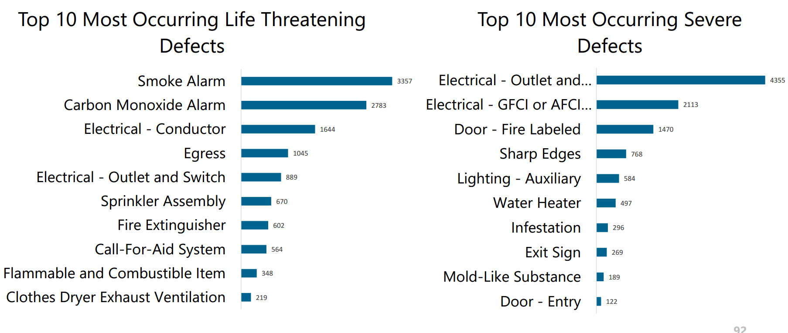
Top Defects
Based on Pilot Demonstration

Slide 25
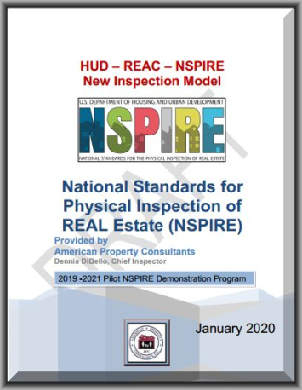
V 3.0
63 Standards
More than just a definition
NSPIRE Standards
Definition is part
of a Standard

Slide 26
NSPIRE Standards Format
TITLE:
VERSION
DATE PUBLISHED:
================================
DEFINITION:
PURPOSE:
NAME VARIANTS:
COMMON MATERIALS:
COMMON COMPONENTS:
LOCATION: UNIT; INSIDE; OUTSIDE
MORE INFORMATION:
------------------------------
DEFICIENCY 1: (2,3, etc)
LOCATION: UNIT; INSIDE; OUTSIDE

Slide 27
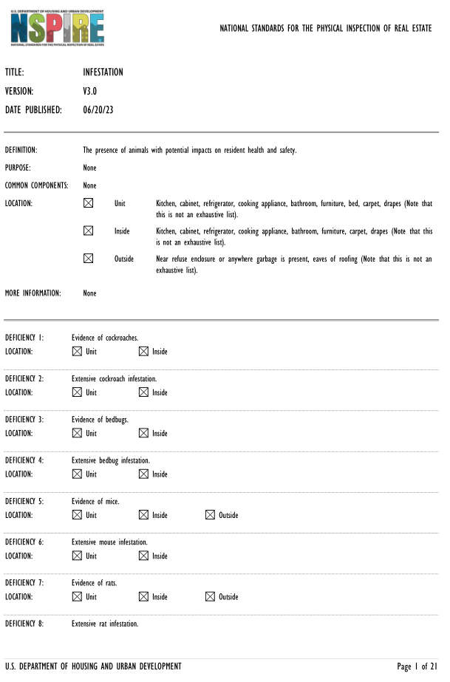

Slide 28
NSPIRE Standards Format
DEFICIENCY 1 – UNIT:
------------------------------------------------------------------------------------
DEFICIENCY CRITERIA:
-------------------------------------------------------------------------------------
HEALTH AND SAFETY DETERMINATION: life-threatening, standard
CORRECTION TIMEFRAME: 24 hours ; 30 days
HCV - Pass/Fail
HCV - CORRECTION TIMEFRAME: 30 days
----------------------------------------------------------------------------------------
RATIONALE
CODE: (Resident 1-7; Maintenance 1-6; Property 1)
CATEGORY: health, safety, sanitary, privacy, maintenance;
TYPE (direct/Indirect)
DESCRIPTION;
EXPLANATION
------------------------------------------------------------------------------------------
INSPECTION PROCESS:
  OBSERVATION
  REQUEST FOR HELP
  ACTION
  More Information
TOOLS OR EQUIPMENT:
  REQUIRED
  USEFUL

Slide 29
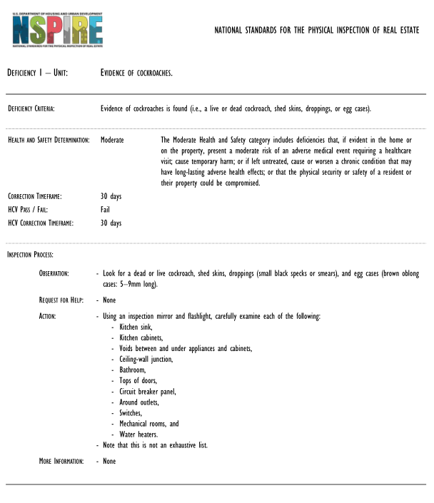

Slide 30
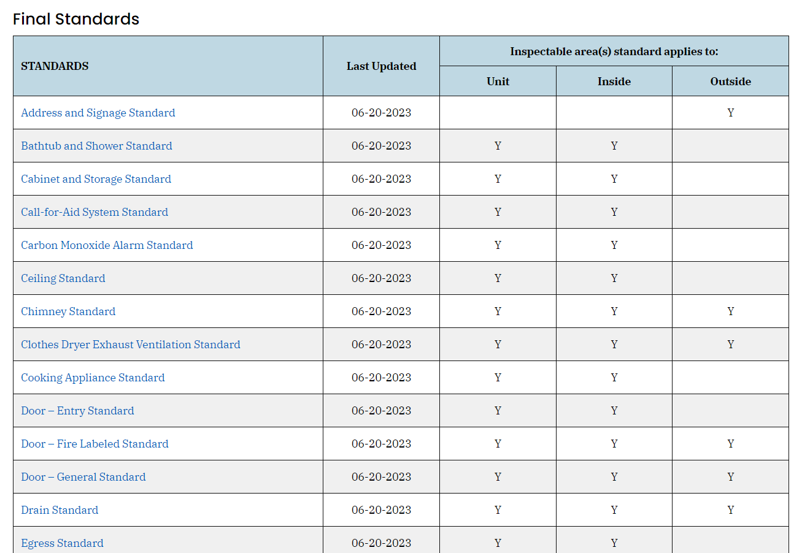
63 Standards
https://www.hud.gov/program_offices/public_indian_housing/reac/nspire/standards

Slide 31
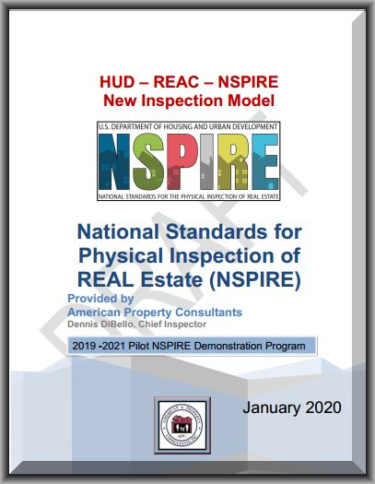
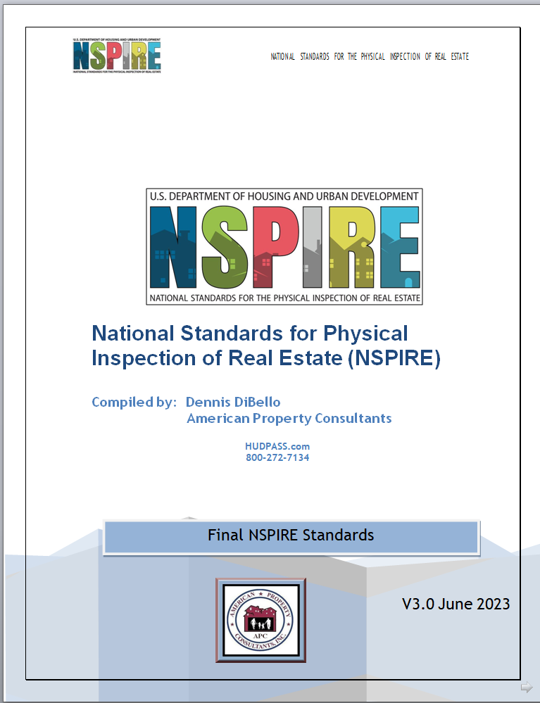
Download your FREE compiled
NSPIRE Standards v3.0 in a pdf file at:
www.HUDPASS.com
Click on the banner NSPIRE
Standards Document
Enter the following:
Username: APC-NSPIRE
Password: APC-NSPIRE
*ALL CAPS
-----------------------------------------------
Take Away 1
126 page booklet

Slide 32
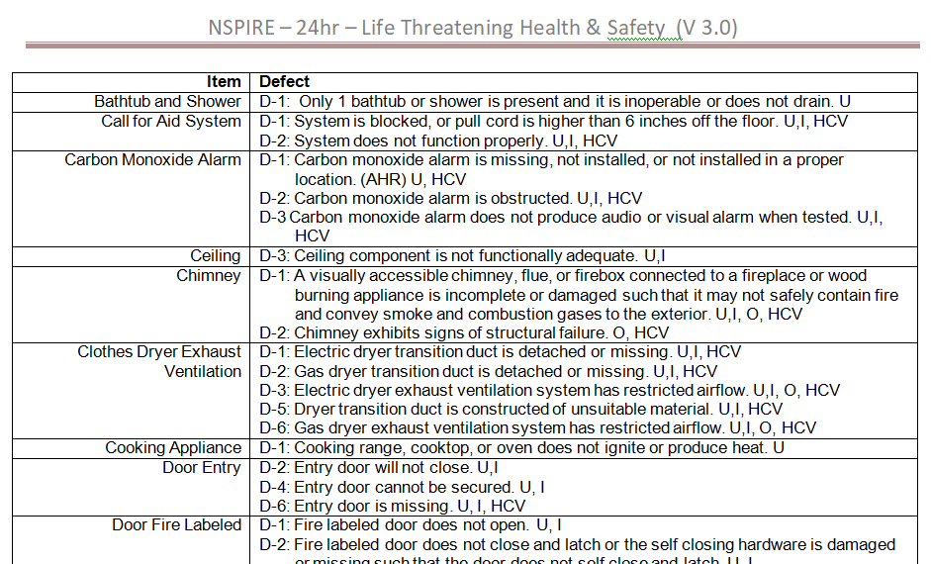
NSPIRE – Life Threatening (LT) (HCV)

Slide 33
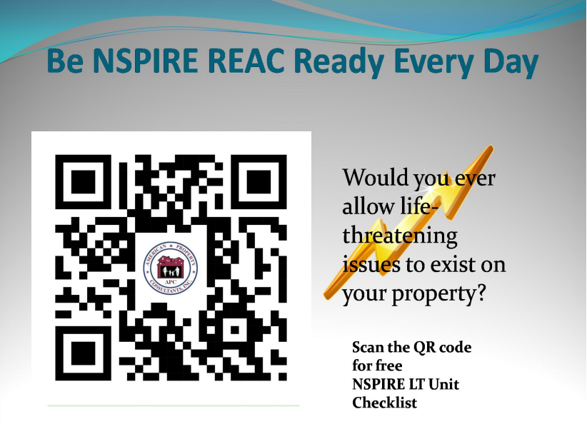

Slide 34
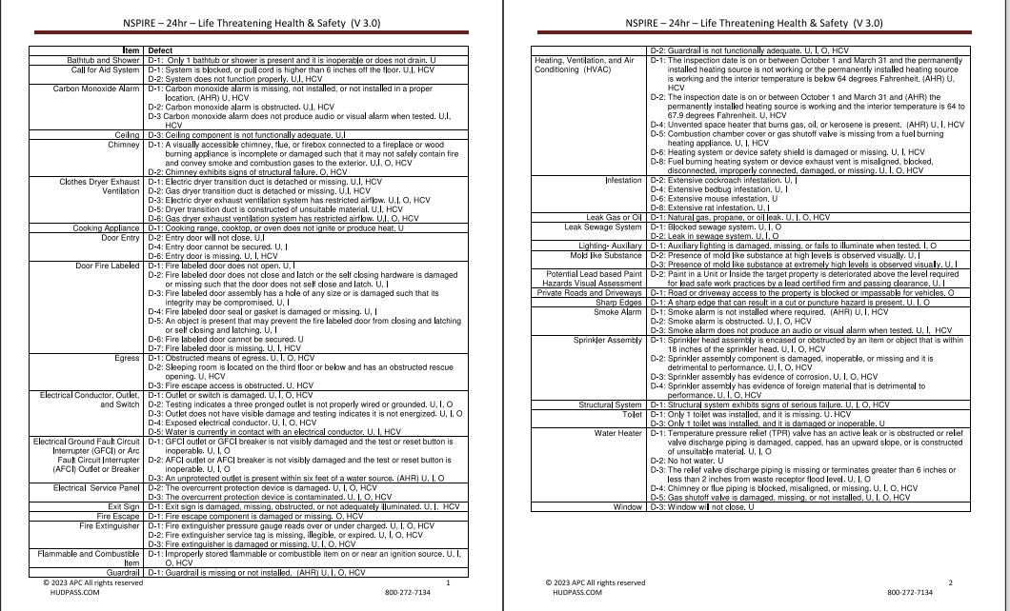
NSPIRE LT/HCV QR Code Download
Take Away 2

Slide 35
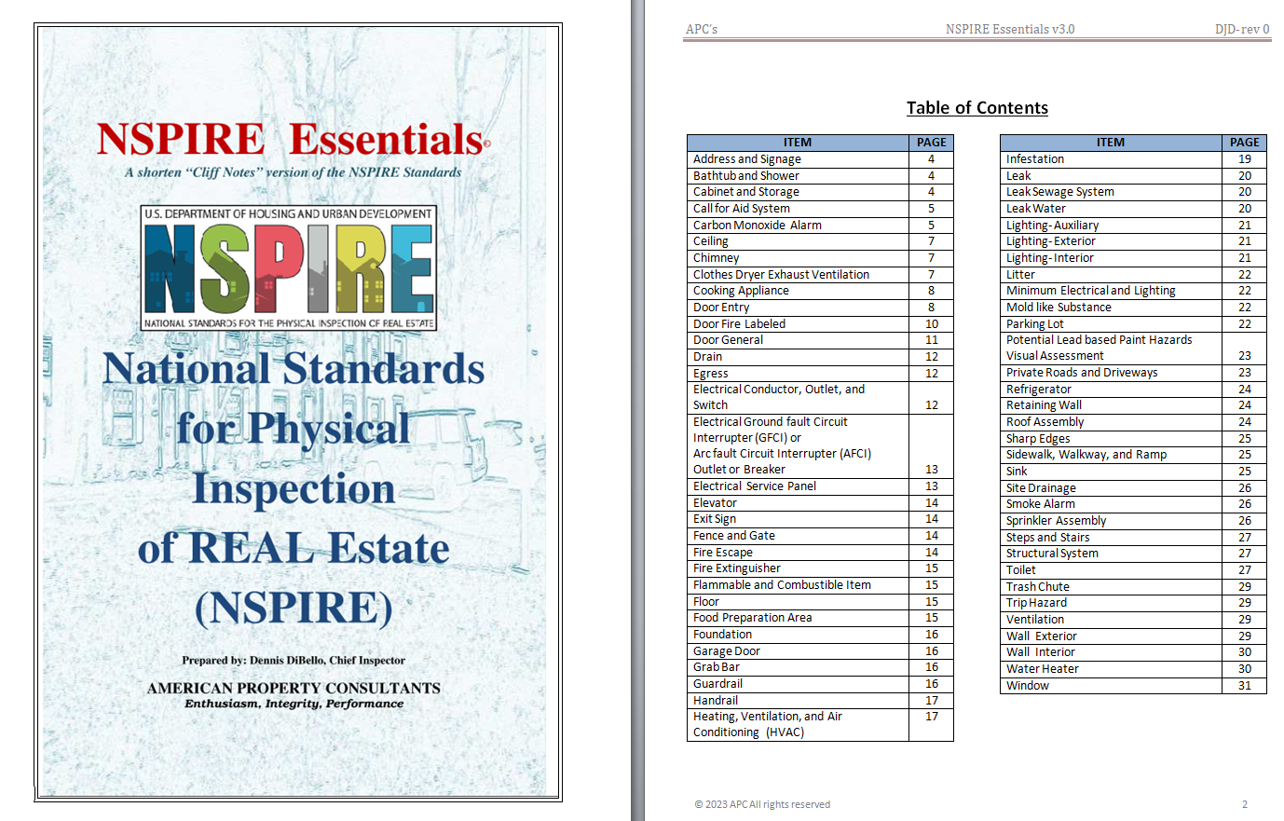

Slide 36
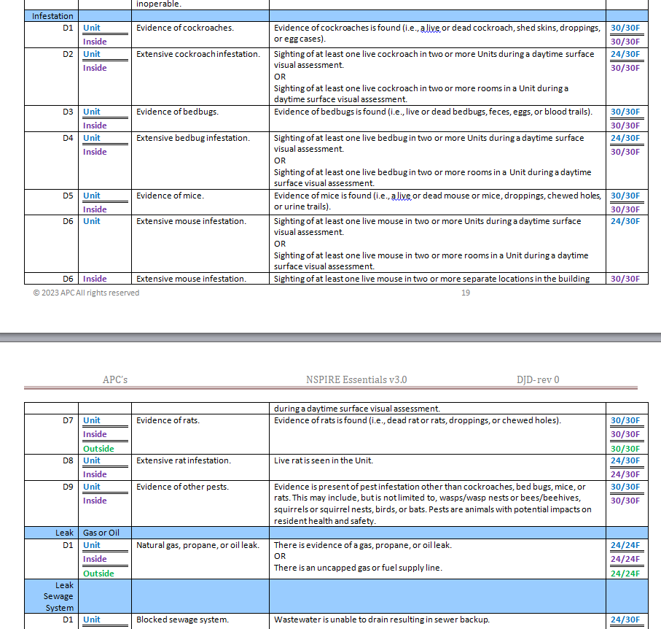
NSPIRE Essentials
The Basics of NSPIRE
(Cliff Notes)

Slide 37
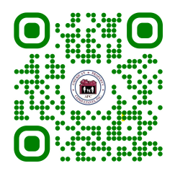
NSPIRE Essentials Download
Take Away 3
Over 500 pages reduced to 31
Consolidated groupings
Focused correction times
HCV Fail
ESSENTIALS

Slide 38
HCV Retains Pass/Fail
As noted HCV program elements will stay the same.
NSPIRE only changes the inspection items and defects.
There may be more program guidence issed in the future

Slide 39
HCV Repair Times
Life Threatening 24 hours
Severe 30 Days
Moderate 30 Days
Low NA

Slide 40
HCV Repair Times
Life Threatening 24 hours
Severe 30 Days
Moderate 30 Days
Low NA

Slide 41
Affirmative Requirements (AHR)
The final rule includes six affirmative requirements that address health and safety issues.
Installation of smoke alarms/detectors in each sleeping area and each floor/level of unit;
Carbon monoxide detectors in each unit;
GFCI outlets if within six feet of a water source;
Guardrails on elevated walking surfaces that have a drop-off of 30 inches or more;
Permanently mounted light fixtures in kitchens and bathrooms; and
A permanently-installed heating source.

Slide 42
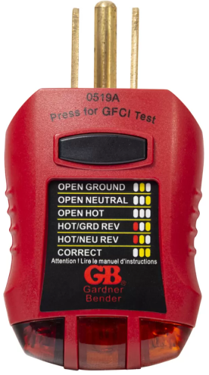
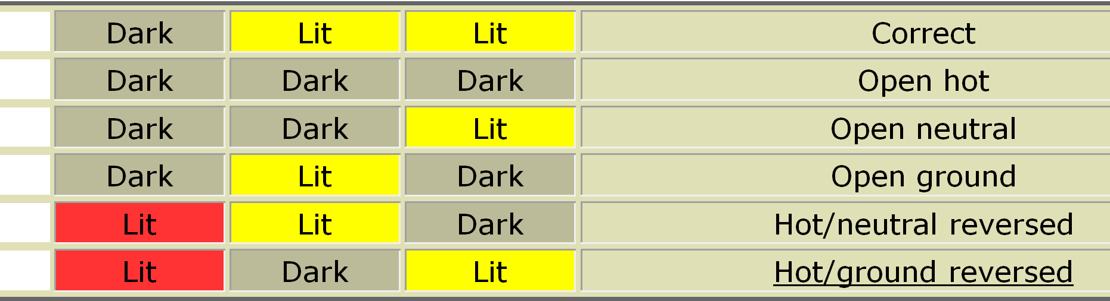
Electrical Outlet Testing

Slide 43

HUD Lead Based Paint Visual Assessment Training Course
https://apps.hud.gov/offices/lead/training/visualassessment/h00101.htm

Slide 44
Major Changes to REAC
are HERE
Don’t sweat-REAC;
Get PRE-NSPIRE'd instead©
“
Dennis DiBello,
COO/Chief Inspector
APC@chesapeake.net
800-272-7134
https://hudpass.com

